Slide 1
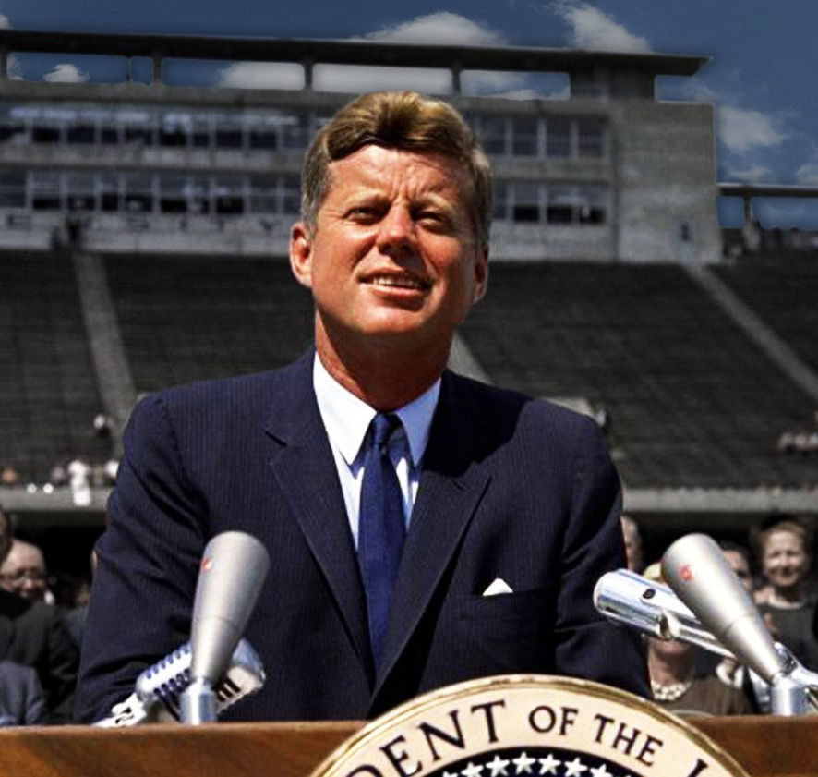
“We choose to go to the moon in this decade and do the other things not because they are easy, but because they are hard. Because that goal will serve to organize and measure the best of our energies and skills, because that challenge is one that we’re willing to accept. One we are unwilling to postpone.”
What would JFK say today?
Notes:
Let me venture a paraphrase of what President Kennedy said in 1962, when he announced the US would go to the moon, updated for today. He might now say:
We choose to go to net zero emissions in every country on Earth, in the coming quarter century, by 2050 or sooner, and do the other things that have to be done to protect the stability of our climate and biosphere even as we deliver clean energy in abundance to everyone on Earth, leaving no-one behind, not because these things are easy, but because they are necessary, and because we know that we can.
Let’s look at how this might be financed. We already have the technologies we need in hand. What about the financial engineering?

Slide 2








Unlocking private capital to incentivize global public goods provision:
Climate policy, clean energy finance and forest protection
Notes:
A core question of our time is how we can increase private investment flows to developing countries to fully finance sustainable development, leaving no-one behind, and making sure as we do so that we return within the global envelope of safety, within the crucial planetary boundaries that define sustainability. We have to redirect vast flows of financial savings in the direction of sustainability. How can we do that? Here’s a hypothesis: We can do it by de-risking sustainability-linked bonds and loans in ways that allow us to scale them up to trillions of dollars a year. Let’s look at how that could perhaps be done.

Slide 3
Mobilising Private Finance for the Climate Agenda:
Introducing Sustainability-Linked Intermediated Debt Instruments (SLIDIs)
Marcello Estevão
Stephen Stretton
Nils (Jasper) Zimmermann*
With thanks to Evie Davey for assistance in developing slide deck
*Presenter
*Please note: these remarks are made in a personal capacity and do not represent the views of any institutions we are affiliated to

Slide 4
Contents
Why SLIDIs?
Sustainability-Linked-Bonds: Current Concept & Shortcomings
SLIDI Definition & Design Options
  Option One: Subsidy
  Option Two: Trusted Intermediary
World Bank/Lead MDB Role
Development Partner Roles
Conclusions & Next Steps

Slide 5
I. Why SLIDIs?

Slide 6
Mobilize Investment
There is a need to attract increased capital from private investors on a large scale to support climate action in developing countries.
Incentivize Action
Incentives must be put in place to encourage developing countries to prioritize climate action and green investments.
Reduce the Risk
It is essential to de-risk this operation, minimizing variability for investors and maximizing overall impact for developing countries.
Why SLIDIs?

Slide 7

Global net zero by 2050 requires annual investment of US$3.4 trillion to $8.1 trillion globally
(Yilmaz et al. 2022)
Developing countries alone need $2 trillion annually (IMF, 2023)
IMF (2023) estimates 80% of necessary investment must come from the private sector
Current Annual Flow of Private Sector Investments to Developing Countries (US$bn)
Data Sources: IMF (2023); OECD (2021)
Notes:
To achieve global net zero by 2050, annual investments from US$3.4 trillion to $8.1 trillion are needed globally (Yilmaz et al. 2022)
Flow of climate finance from developed to developing countries in 2020 was estimated at $21 to $83.3 billion (UNFCCC), far below required level

Slide 8
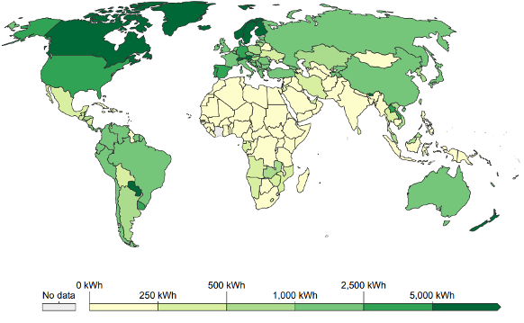
Developing countries have difficulty accessing financing for renewable energy infrastructure, and their cost of capital is often high
For utility-scale solar PV projects in 2021, financing costs constituted about 50% of the LCOE in emerging markets versus less than 30% for developed economies (IEA and IFC, 2023).
Electricity Generation From Renewable Sources
(per capita, per year)
Source: Babayomi, O., Dahoro, D. & Zhang, Z. (2022).
Notes:
1. Countries with low financial development and less developed financial institutions are less able to attract private capital. 2. High cost of capital makes the initial investment requirements for many projects, like renewable energy, infeasible. 3. In many developing countries, dramatic reductions in the cost of capital and access to low-cost financing will be necessary to enable a boom in clean infrastructure projects.

Slide 9
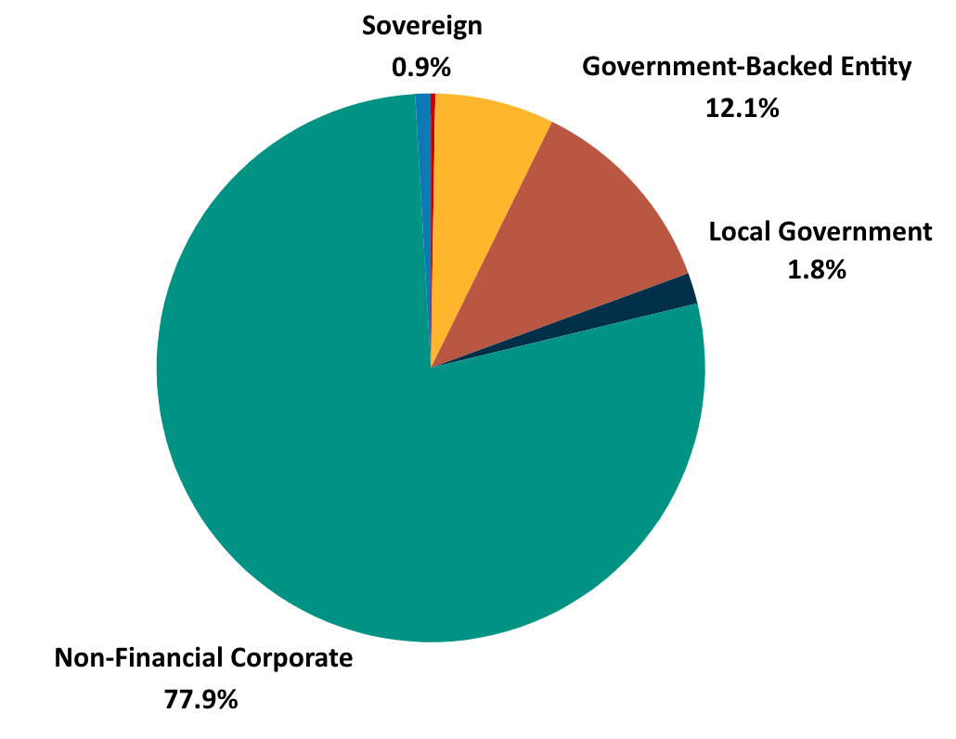
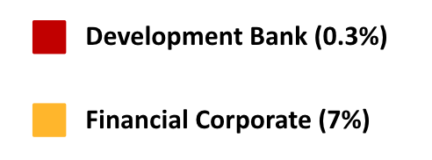
Current incentives structures and mechanisms are limited either in scope or in scale
SCOPE→ Tragedy of the Commons & Horizons: private sector and policymakers lack incentives to prioritise long-term climate goals.
SCALE→ SLBs primarily cover project-specific ESG goals rather than national climate goals.
Issuers of SLBs
Data Source: Climate Bonds Initiative (2024)

Slide 10
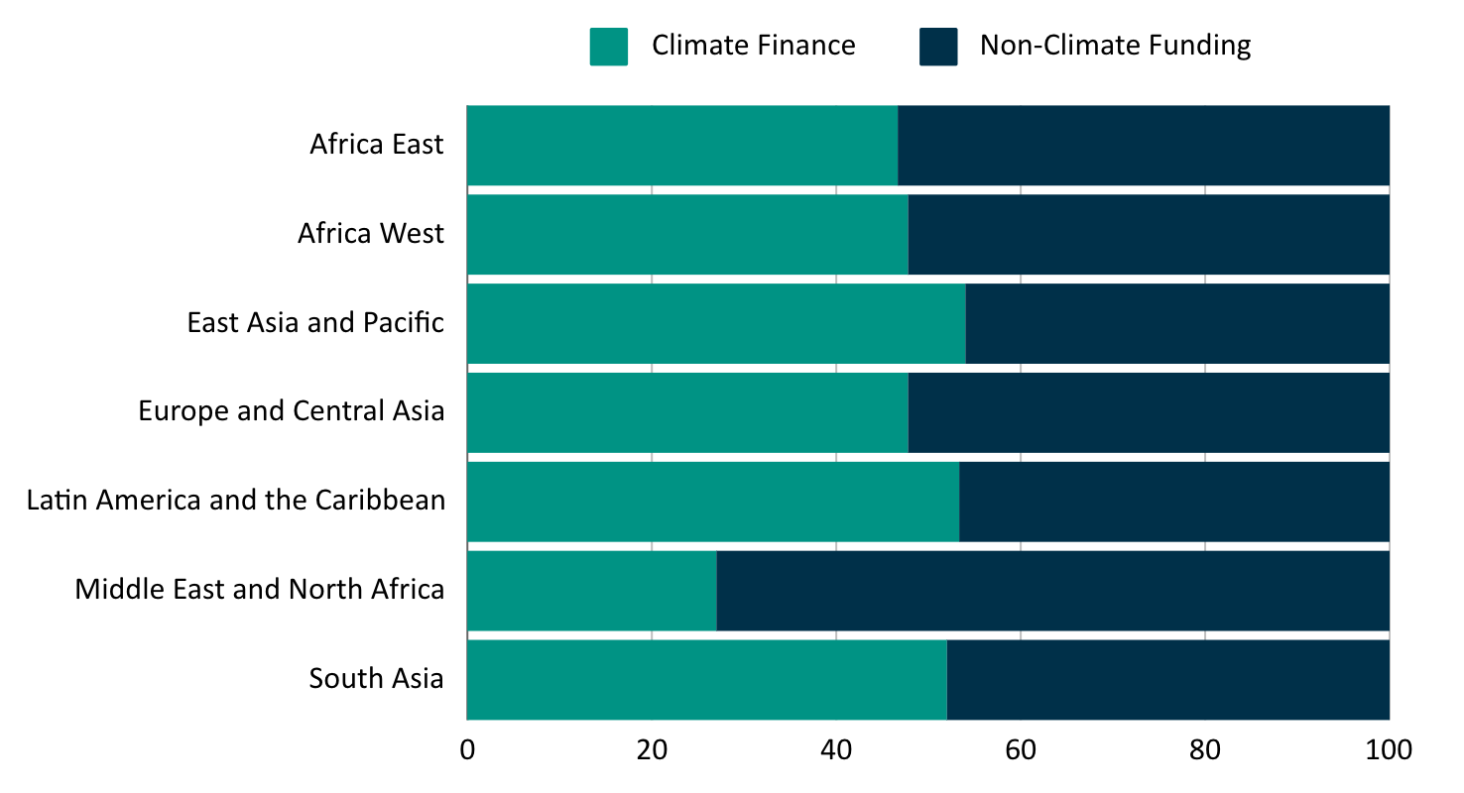
Expanding the World Bank’s Role in Addressing Climate Change
Broader objective to scale up climate funding within the World Bank to achieve its climate finance goal of 45% of total lending for FY25.
Need for new solutions to avoid conflicts between climate priorities and fiscal responsibilities.
World Bank Regional Lending FY24
Data Source: World Bank (2024)

Slide 11
Countries need stronger incentives for policy action for global GHG emissions mitigation and climate adaptation
Sustainability Linked Bonds (SLBs) and Sustainability-Linked Loans (SLLs) are useful innovations to achieve these goals, but have not achieved necessary scale
&
Developing countries are in critical need of access to cheap finance to build clean energy and climate resilient infrastructure
Sustainability-Linked Intermediated Debt Instruments (SLIDIs) build on SLBs and SLLs to unlock climate and clean energy finance flows
Notes:
This presentation looks at how developing country sovereigns could best borrow large volumes of money cheaply from private sources to finance their transitions to clean energy abundance within a global transition to net zero greenhouse gas emissions. As populations and prosperity rise, most future emissions will come from developing economies. A big challenge is that developing countries generally have to pay high interest rates, due to foreign exchange and other country risks. One answer that has been offered to incentivize policy shifts toward lower emissions are “sustainability-linked bonds,” or SLBs, in which a sovereign pays a lower interest rate on bonds to the bond buyers if the country meets some key performance indicators, such as a target level of emissions per unit of GDP, and a higher rate if it fails to meet the target specified in the bond covenants, the bond’s terms and conditions. To date, sustainability-linked bonds have mostly been issued by corporations, not sovereigns. SLBs are a good idea and a step in the right direction, but we think this idea can be improved upon, and applied to sovereign borrowing. In our paper, we present two different possible ways SLBs could be adapted and improved to help developing-country sovereigns access lower-cost financing in exchange for sustainability-enhancing policy changes and infrastructure investments. For reasons that will become clear, we refer to these instruments as SLIDIs, or sustainability-linked intermediated debt instruments. SLIDIs are designed to de-risk lending to developing country sovereigns and at the same time, reward developing country sovereigns for achieving measurable improvements in agreed sustainability indicators.

Slide 12
II. Existing
Mechanisms & Limitations
Notes:
Most SLBs are corporate SLBs e.g. ENEL

Slide 13
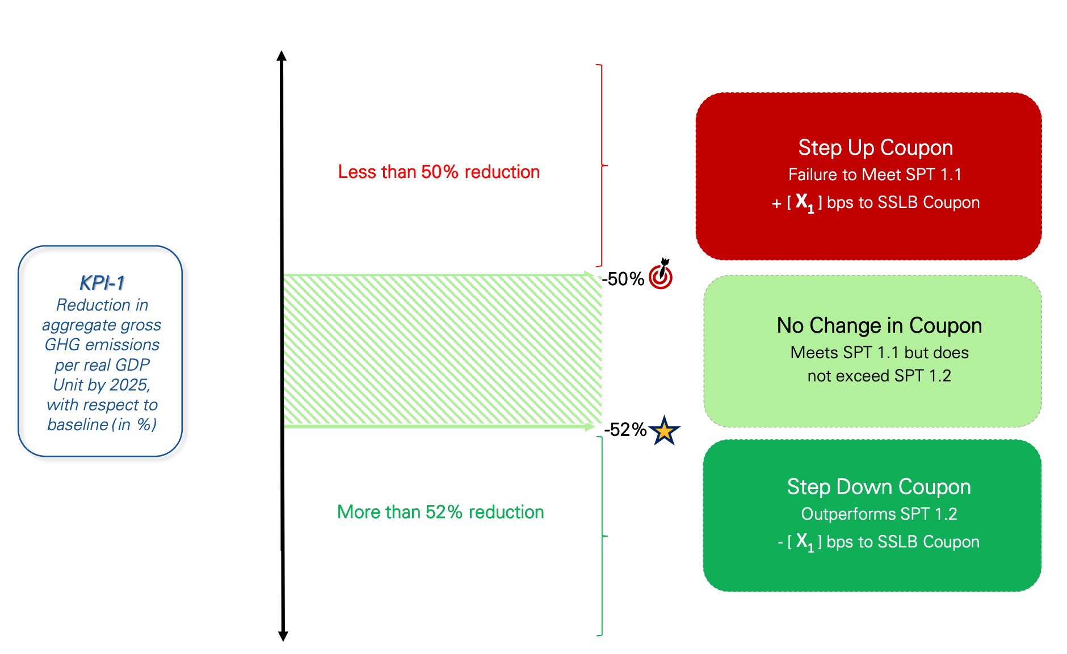
Existing Mechanism:
In 2022, Uruguay issued a 3-year USbn$1.5 Sovereign SLB
Existing Sustainability-Linked Sovereign Bonds:
Uruguay
Notes:
It’s worth noting that the overwhelming majority of SLBs that have been issued to date, since SLBs first were introduced in 2019, have been corporate SLBs, not sovereign SLBs; there have only been a couple of sovereign SLBs. And the volume of corporate SLBs has been declining since a peak two or three years ago. We think that might have to do with some design flaws in the current generation of SLBs.

Slide 14
Existing Mechanism:
In 2023, the World Bank directly issued a US$350 million Sustainability-Linked Loan also to Uruguay
Also note recent WB SLB/SLL transactions in Kenya and Rwanda.
Beginning in 2028
Linked to a reduction in methane emissions per unit of cattle
Targets are 1% more ambitious than Uruguay’s NDC
If this target is met, WB will reduce the interest rate for each year

Slide 15
Existing SLBs’
Limitations
Disincentives for Investors (Perceived Risks), due to variable interest rates
Disincentives for Sovereign (Step-Up Mechanism)
General Market Resistance
Notes:
Disincentives for Investors:
Activist investors are uncomfortable with higher coupon payments linked to failure to achieve climate objectives
Investors are exposed to risks related to non-payments
Disincentives for Sovereign:
Nearly 95% of SLBs employ a step-up coupon structure (Berrada et al., 2022)
Sovereigns are financially penalized for not achieving KPI targets, rather than being rewarded for outperforming
Complexity:
While SLBs hold great potential, they have not seen widespread adoption from sovereigns or financial institutions
Perceived complexity is a key deterrent
Uptake of uniform standards for targets has been slow

Slide 16
“SLBs have, however, faced considerable criticism since their 2021 boom… But the problems lie in inadequate structural and calibration features, and weak underlying transition plans – not with the sustainability-linked concept.” (Climate Bonds Initiative, 2024)

Slide 17
III. SLIDIs: Definition and Design Options
Notes:
We offer two very different possible SLIDI designs

Slide 18
SLIDI: Definition
A Sustainability-Linked Intermediated Debt Instrument is a debt instrument (bond or loan), intermediated so that coupon/interest payments made by borrowers are KPI-linked but the coupon/interest payments to end investors are not.

Slide 19
Intermediary/WB
Donor
Pays out subsidy (RBP, results-based payments), e.g., 2%, from WB-managed trust fund if sustainability KPI targets are met
Raises money for trust fund for RBPs, e.g., via carbon tax
Sovereign
Issues bonds to financial markets at fixed interest rate, e.g., 7%
Investor
SLIDI Model 1: Subsidy-Providing Intermediary
Notes:
The donor might be a coalition including several oil-rich nations and the European Union, for example

Slide 20
SLIDI Model 2: Credit Intermediary (Specialized Development Bank)
Intermediary/WB
e.g. pays 7% p.a. until KPI performance assessment deadline.
e.g. pays constant 4% p.a.
Issues bonds in the market e.g. at 4% (if investment threshold is met) and then on-lends to the sovereign
e.g. pays 5% until bond maturity if KPI targets are met and 4% or 3% if targets are subsequently exceeded
Verifies KPI targets are ambitious and relevant and tracks progress; on-lends money to EMDE sovereign via SLL
Sovereign
Investor
Notes:
Some key points here are that we know development banks are a proven model, and that the reason we might need a separate vehicle with its own balance sheet for this purpose is that it’s unlikely that all shareholders of the World Bank or other existing development banks will agree to increase the size of the existing banks’ balance sheets to the extent required, so instead, it might be possible to create a separate balance sheet backed by a coalition of willing wealthy sovereigns, yet managed by an existing development bank. I’ll emphasize again that my co-authors and I are floating ideas here in a purely personal capacity, this is not a policy under development in the World Bank or any other development bank, and we’re not speaking for any existing institution!

Slide 21
Debt-For Nature Swap (Ecuador) with Guarantees
IDB
Financial Guarantee
Some precedent can be found in a recent Debt-for-nature swap in Ecuador
It consists of an $85 million IDB guarantee and an $656 million DFC political-risk insurance.
Estimated to generate savings of $323 million to finance conservation activities in the Galápagos (IDB, 2023).
First time an MDB has provided financial guarantees coupled with insurance against risks to promote sustainability at the state level.
Largest debt-for-nature conversion in the world.
Repays debt at cheaper rate
Ecuador
Creditors
Risk Insurance
New Funds
US DFC
Conservation Efforts

Slide 22
IV. Role of the World Bank (or other leading MDB)

Slide 23
WB Role: Standard Setting
The World Bank, or similar institution, could also play a key role in standardizing the metrics and KPIs to ensure strong climate action.

Slide 24
WB Role:
‘Halo’ Effect
The involvement of the World Bank or another MDB (e.g. by the WB purchasing some of the final bonds issued to investors) may create a strong market signal—a ‘halo effect’—that reduces the risk of sovereign default, boosts bond credibility, and increases its appeal to private investors.

Slide 25
WB Role: Lending Directly or Setting Up SPV
The World Bank could lend directly (sustainability-linked loan) or help to set up a Special Purpose Vehicle to do additional lending.

Slide 26
V. Development Partner Roles

Slide 27
Roles of Development Agency Partner in Enhancing SLIDI Success
Development Agency Partner (e.g. GiZ or AFD)
Agency reports client country progress on KPI targets to lender
Agency gives technical support and advice to EMDE institutions
Agency verifies KPI targets are ambitious and relevant and tracks progress
Sovereign
Lender

Slide 28
VI. Conclusions & Next Steps

Slide 29
Conclusions
Urgent need for innovative solutions to mobilize private capital for sustainable infrastructure development objectives.
Room for Improvement with SLBs.
Enhanced Approach - SLIDIs with WB/MLDB Operationalization:
A more attractive and effective financial instrument for investors and sovereigns.
Operationalization through side payments or intermediary (WB or SPV)
Development agency partner participation to enhance private-sector confidence and help achieve KPIs.
Notes:
Problems observed in existing SLBs: complexity, variable coupon payments, and market resistance
Choice of ‘Prior Action’ or ‘Results Based Climate Finance’ system, with former choice reducing financial risk to WB and latter offering stronger performance incentives to client country

Slide 30
Next Steps:
Refinement & Exploration
Co-Design Collaboration
Feedback
Scaling Impact

Slide 31
Bonus Slides on SLIDIs
Motivation
Tie down private sector and official sector flows to climate agenda in developing countries, without compromising WB balance sheet.
Enhancing incentives for private sector financing without hurting incentives for developing countries to achieve climate targets.
Unifying aspects of WB operations and private sector lending into only one bond would hardwire this complementarity and bypass market failures.

Slide 32
How To Implement SLIDIs: Option One
SLIDIs would consist of two components:
Standard sovereign bonds with fixed coupons, but ‘green’ tagged (because of second component…)
WB payments conditional on a) Achievement of KPIs and b) sufficient private sector interest in the first component
How To Implement WB Payments?
Payment-for-results Results Based Climate Finance
DPF lending conditional on schedule of prior actions.
Investor
Sovereign
Receives stable payment of coupon
Pays lower coupon payments when certain targets are met. Is incentivized to pursue climate action.
Partner Agency
WB
Pays to the sovereign a net payment conditional on the KPIs being met
Provides technical assistance to ensure KPIs are met.

Slide 33
How To Implement SLIDIs: Option Two – Trusted Intermediary
SLIDIs would consist of two components:
Standard sovereign bonds with fixed coupons, but tagged ‘green’ (because of second component…)
WB payments conditional on a) achievement of KPIs and b) sufficient private sector interest in the first component
Sovereign 1
Achieves KPI
Pays 5% p.a.
Investor
SPV or WB
Receives stable payment of coupon from SPV
Pays 4% p.a.
Borrows at AAA financing rate thanks to guarantees. Receives 5-7%
Sovereign 2
Pays 7% p.a.
Does not achieve KPI

Slide 34
Further Work / Proposals
Issue | Solution | Proposal
KPI approaches need to reflect the stocks of carbon, not just flow. Carbon markets can give perverse incentives because of lack of permanence. | Define a permanent ‘Notional Capitalized Value’ (NCV) of the stock of forest in each country and pay an ‘interest rate’ (e.g. to begin 0.1% pa) on those values globally according to available funds. | Notional Capitalized Value KPIs
KPI bonds Trusted-Intermediary lending option needs an additional capital buffer and/or guarantees. | Climate Incentive Trust (CIT) collateral funds at national level. | Climate Incentive Trust
Forest protection (including NCV) and maintenance of CIT needs source of funding or financial returns. | Invest the CIT funds in the construction stage of Renewable Energy projects that are refinanced at low financing cost when complete.

